Slide 1


NAU/NASA Space Grant Survey of Arizona STEM Best Practices Part 2
Brooke Knighton
Dr. Eric Savage

Slide 2
The Survey
Consisted of 26 questions
Send to 436 educators across Arizona
Gained insight to Arizona STEM integration
Aligned with SFAz matrix and Massachusetts Dept. of Education STEM Best Practices

Slide 3
Integration Matrix
Exploratory Model - Offered
Introductory Model - Added
Partial Immersion Model - Integrated
Full Immersion Model
- Main

Slide 4
Types of Questions Asked
Demographics
Gender, position, years experience, county, etc.
Rationale
Least/Most difficult to learn/teach, what students will gain from STEM
Integration
Implementation and Evaluation
NASA
Lessons, Professional Development

Slide 5
Analysis
Mixed Results
Compared like questions for accuracy
12.6% response rate

Slide 6
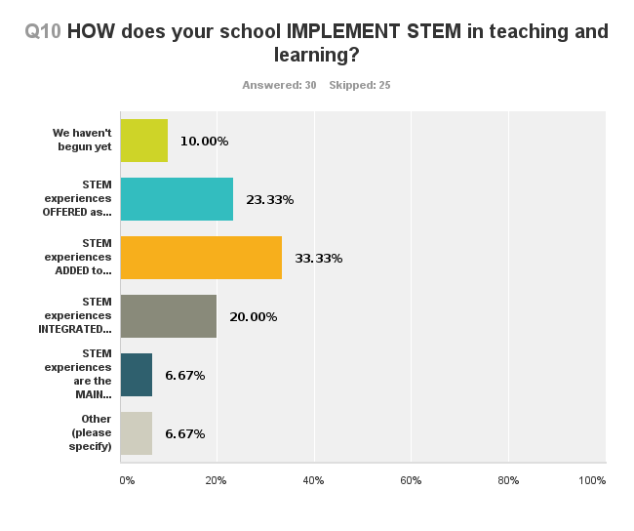
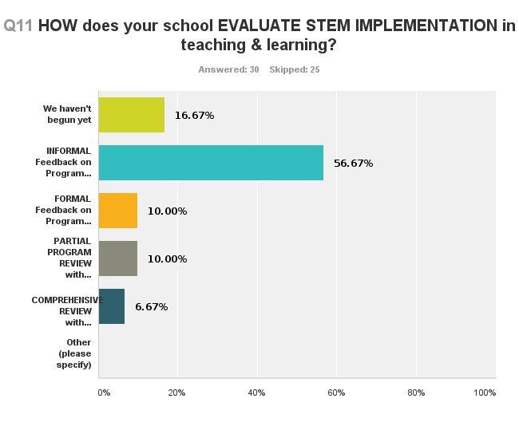
Analysis – Mixed Results
Exploratory Model
Introductory Model
Partial Immersion Model
Full Immersion Model

Slide 7
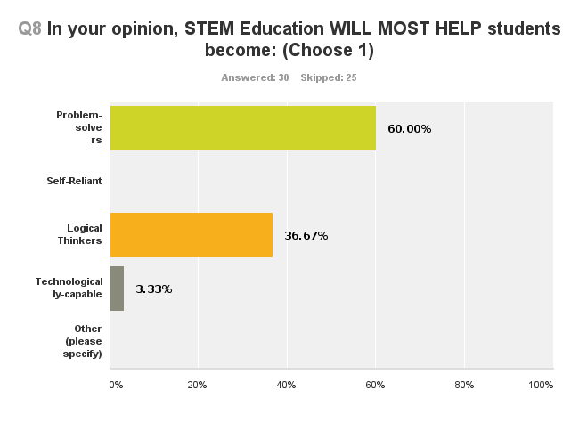
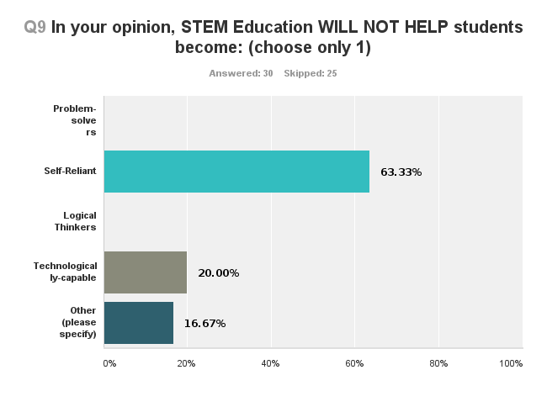
Analysis - Accuracy

Slide 8
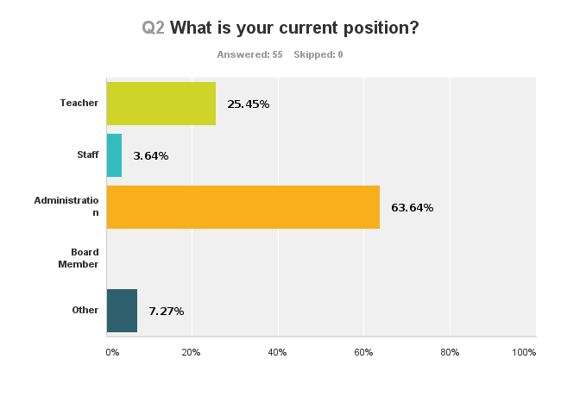
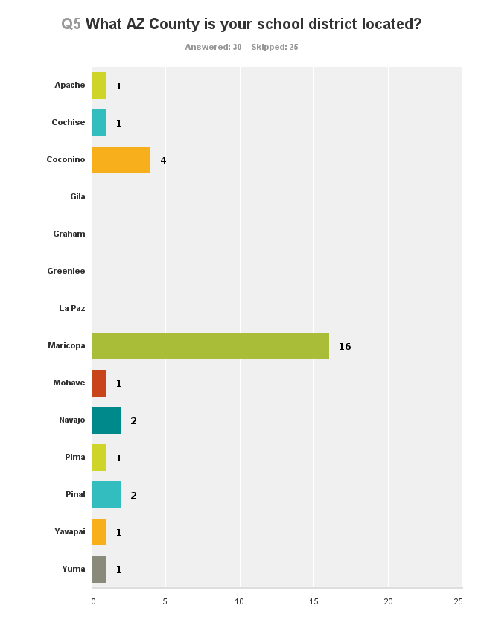
Analysis – Response Rate

Slide 9
Conclusion
Conflicting Data
Subjects have conflicting perceptions on where they stand on the STEM Integration Matrix
Demographics
Majority of respondents were male, administrators, and from urban counties
Response rate does not support statistical significance

Slide 10
Recommendations
Clarify the STEM Integration Matrix
Clear guidelines for what is expected in each category
Expand the current categories
Educate the Educators
Incentivize subjects to increase response rate
Promote more research in STEM Best Practices

Slide 11
Acknowledgements
Dr. Eric Savage – First Flight Education
Dr. Nadine Barlow
Kathleen Stigmon
NAU/NASA Space Grant Internship

Slide 12

Questions?

